Slide 1
Financial Training for
Advisory Councils
Presented by
Julie Collins

Slide 2

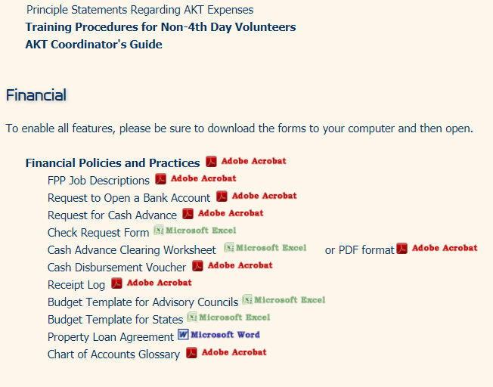
www.mykairos.org/downloads

Slide 3
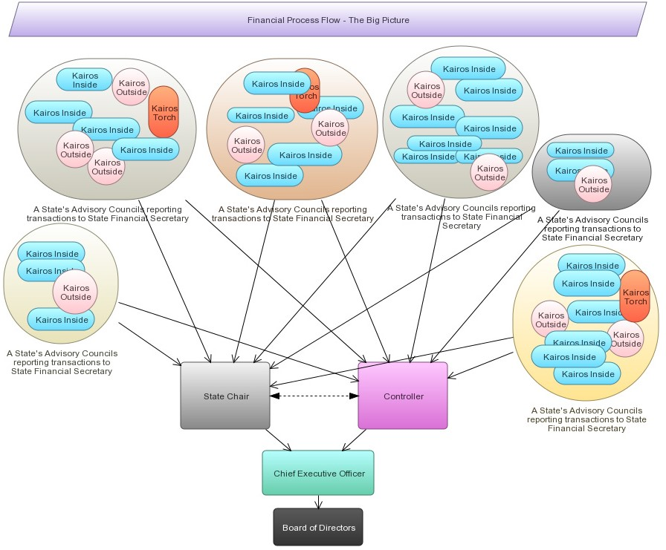

Slide 4

Receipt / Deposits Process

Slide 5
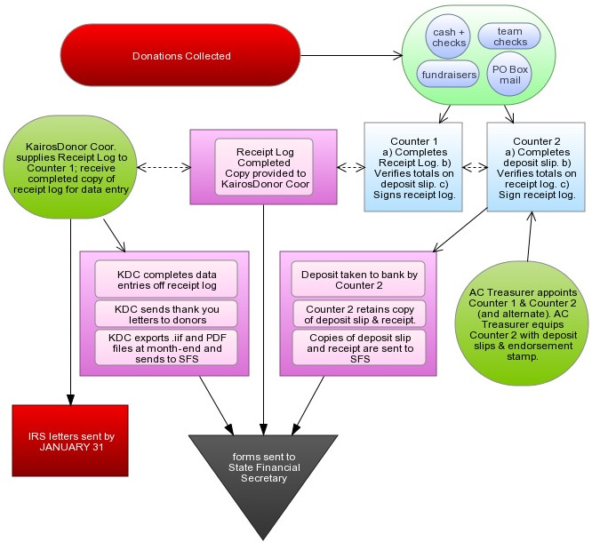

Slide 6
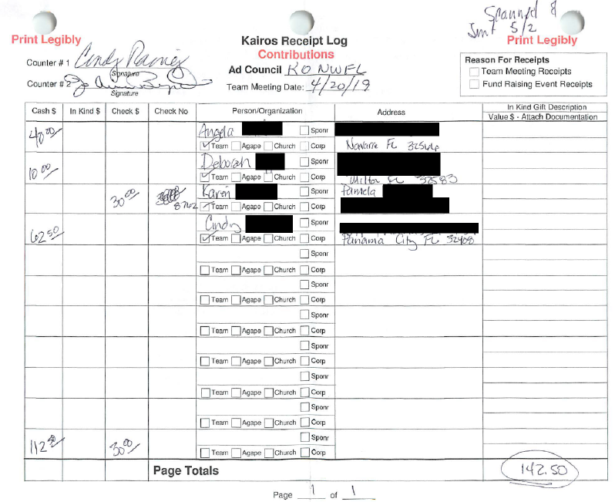
Receipt Log
-two counters signed
-properly completed
-totals

Slide 7
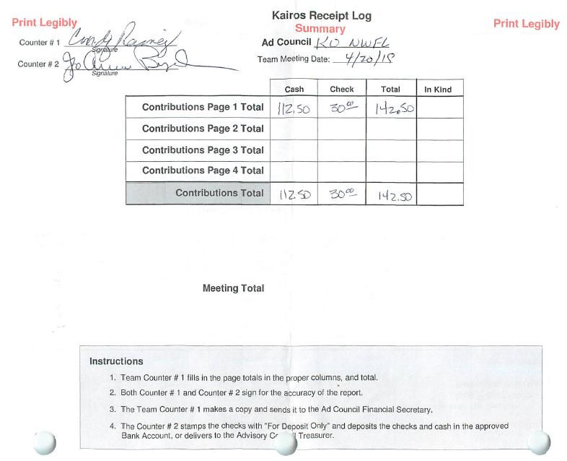
Receipt Log
-two counters signed
-properly completed
-totals

Slide 8
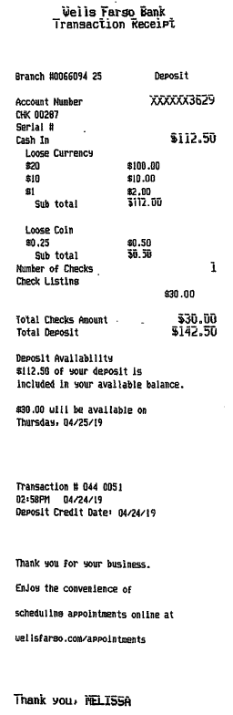
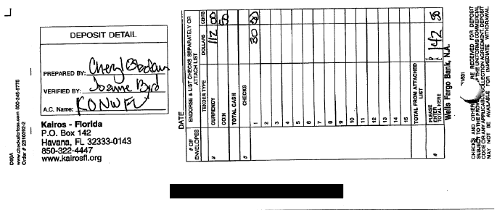
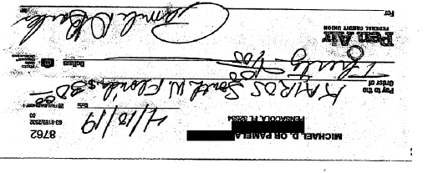
Deposit Slip Bank Receipt Deposited Checks
-Advisory Council Name -totals match -copied [redacted]

Slide 9
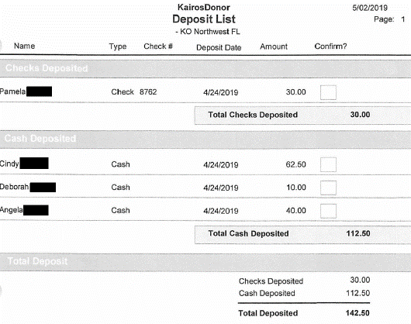
KairosDonor
Deposit List
-names match receipt log
-date match
-totals match

Slide 10
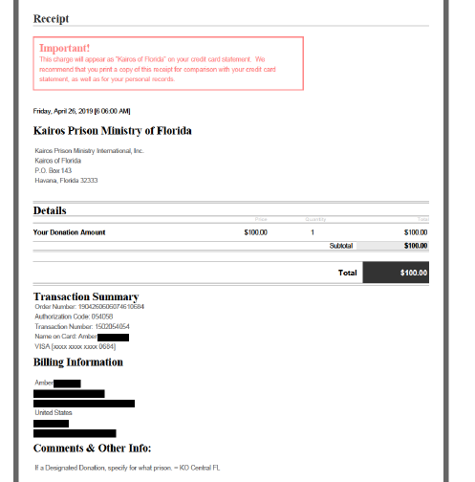
Click & Pledge Online Donation

Slide 11
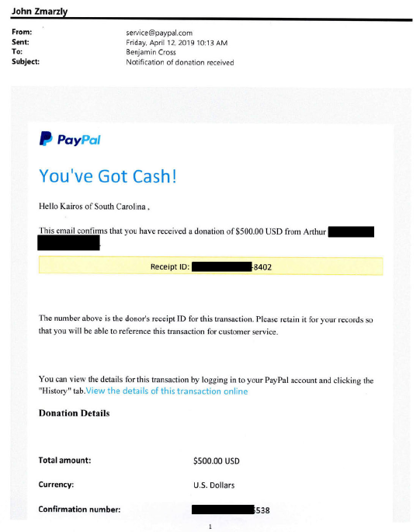
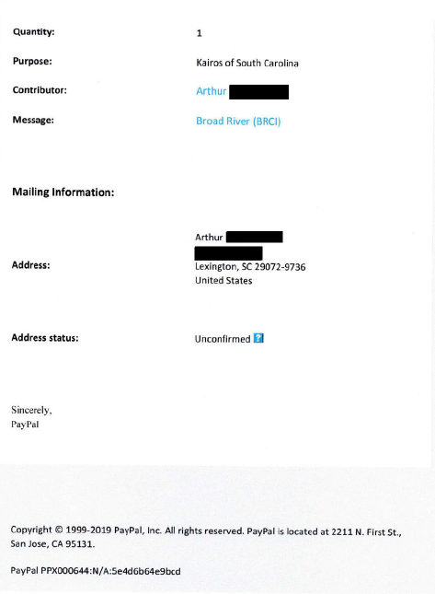
PayPal Online Donation

Slide 12
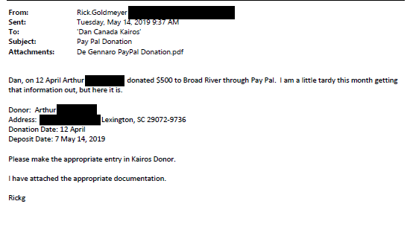
PayPal Online Donation

Slide 13
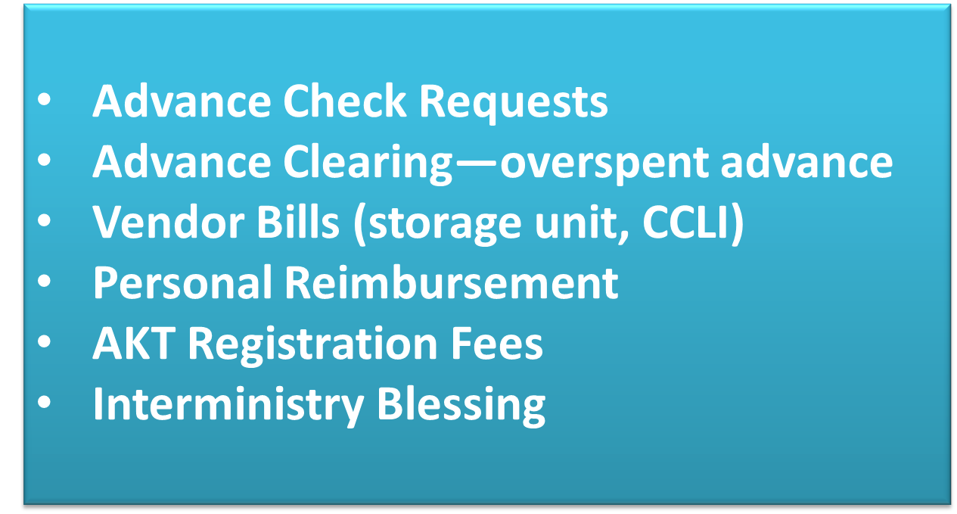
Disbursements / Expense Process

Slide 14
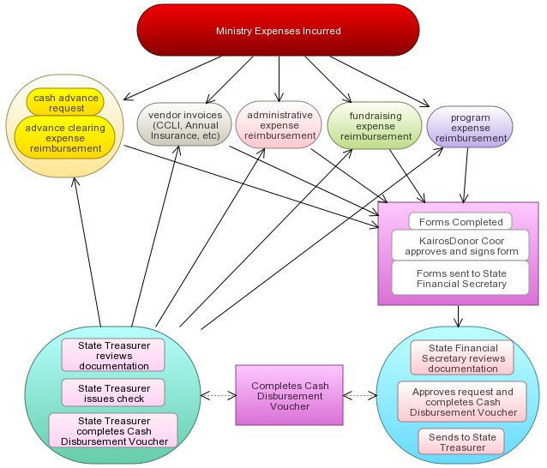

Slide 15
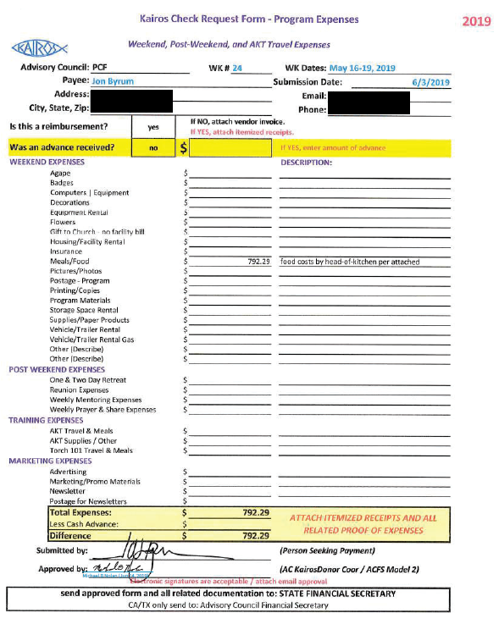
Check Request Form
-all pertinent information is complete on top
-expenses are broken down
-completed and signed by submitter
-reviewed and approved by KairosDonor Coor

Slide 16
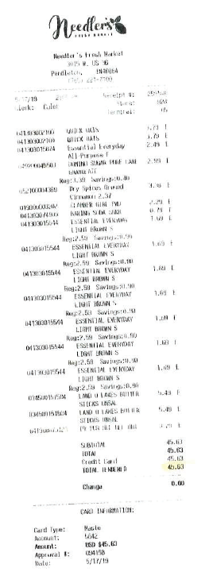
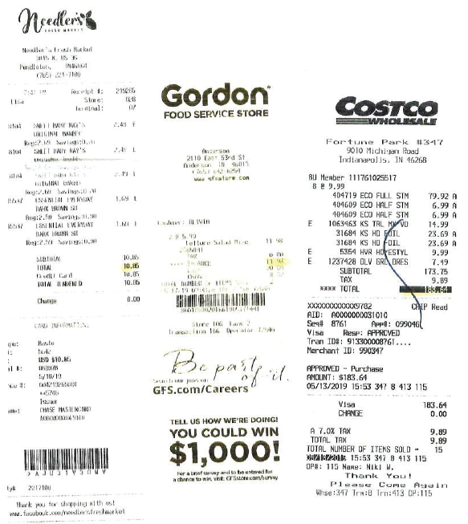
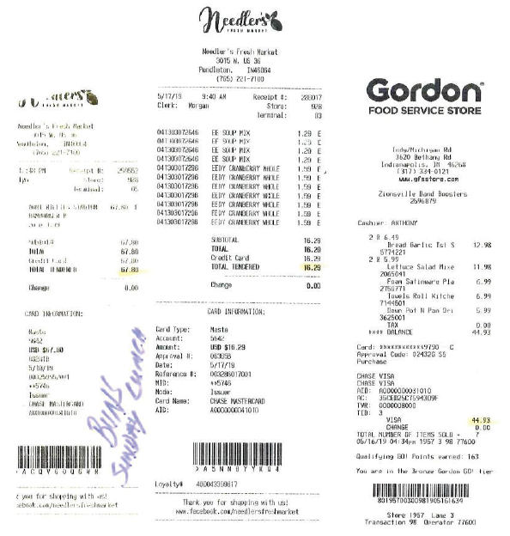
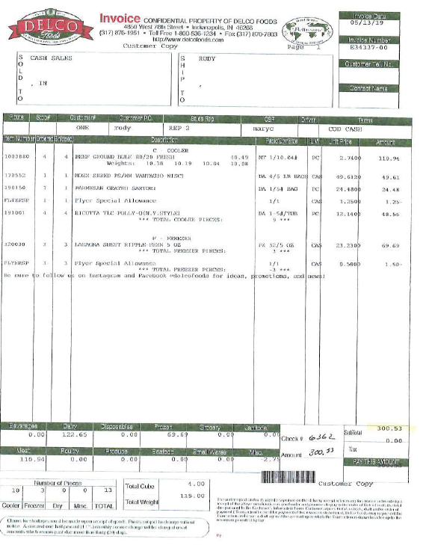
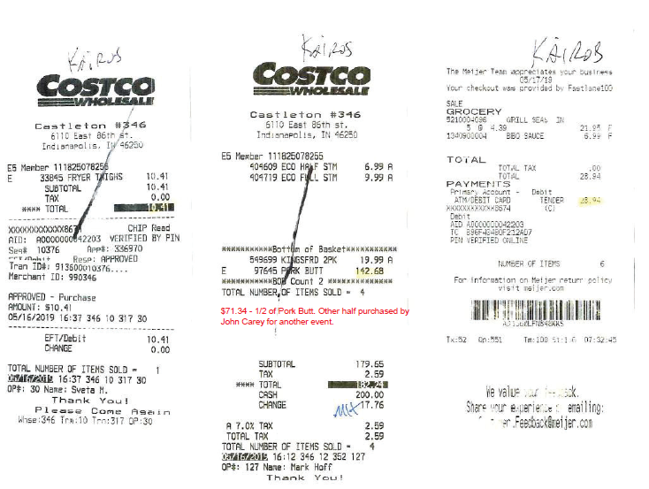
Receipts
-legible / readable
-totals are legible
-expenses are appropriate

Slide 17
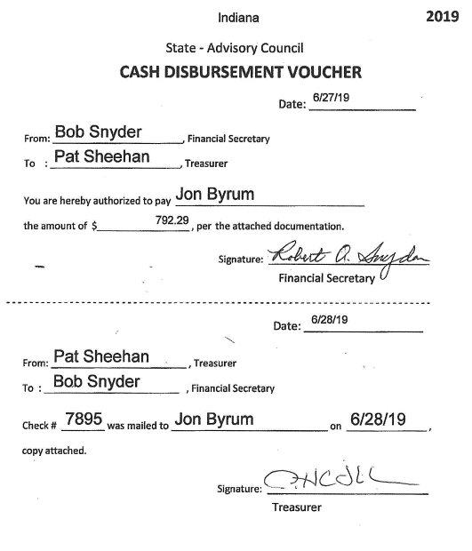
Cash Disbursement Form
-started by Financial Secretary
-completed by Treasurer

Slide 18
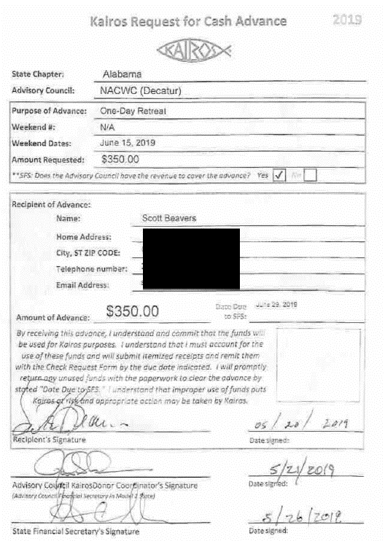
Request for Cash Advance (part i)
-complete info for recipient
-purpose explained
-date calculated for DUE DATE
-recipient signed approval to stipulations
-KairosDonor Coor approval / signature
-State Financial Secretary approval / signature

Slide 19
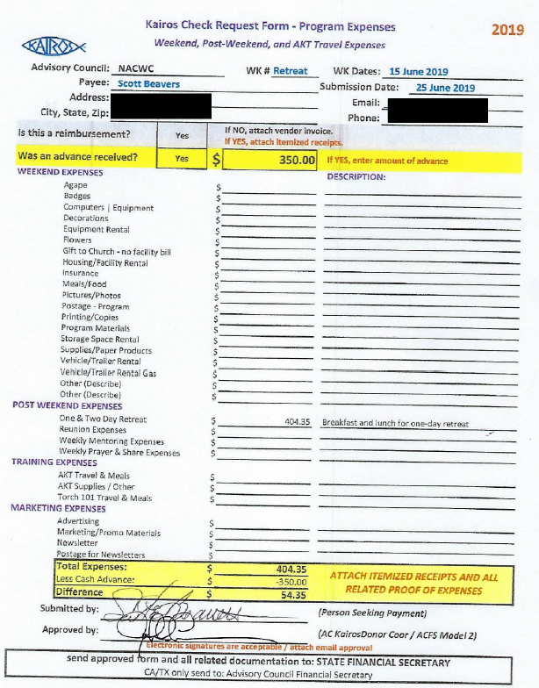
Clearing the Advance (part ii)
CHECK REQUEST FORM:
-all pertinent information is complete on top
-expenses are broken down
-completed and signed by submitter
-reviewed and approved by KairosDonor Coor

Slide 20
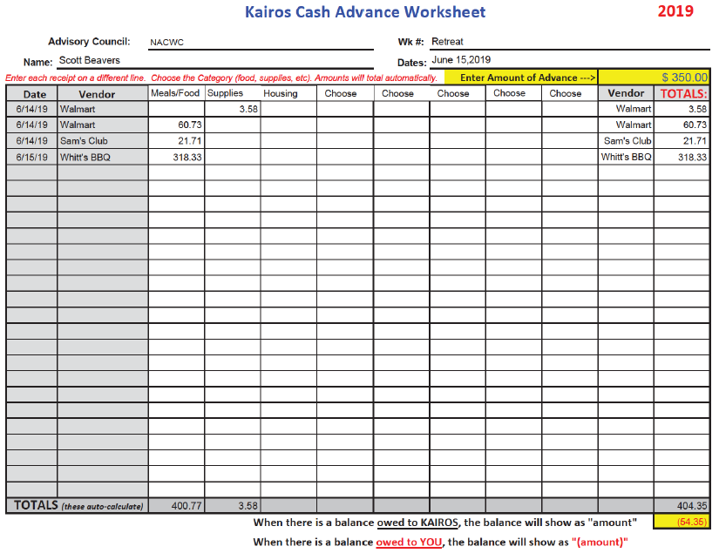
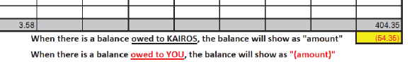
Clearing the Advance (part ii)
Cash Advance Worksheet
(PDF fillable or Excel)
-all pertinent information is complete on top
-expenses are broken down
-completed and signed by submitter
-reviewed and approved by KairosDonor Coor

Slide 21
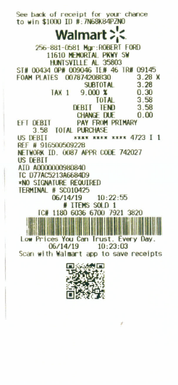
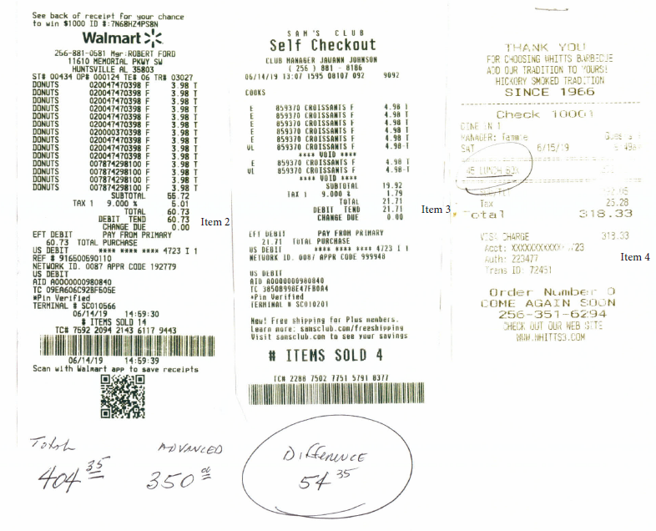
Clearing the Advance (part ii)
Receipts
-legible / readable
-totals are legible
-expenses are appropriate

Slide 22



